Slide 1
Storm water Management Systems
When are they UIC Class V wells?
Notes:
Good Morning!
I am Candace Cady with the Underground Injection Control (UIC) Program in the Ground Water Protection Section of the Division of Water Quality. With me today is Brianna Ariotti whom you already know from her participation in the Utah Storm Water Advisory Council monthly meetings. Brianna, as you know, is also with the UIC Program.
We are here today
to discuss the use of Class V Underground Injection Control Storm Water Drainage Wells in your storm water management programs,
to clarify what is and what is not a Class V Storm Water Drainage Well , and hopefully
to allay any concerns you may have regarding EPA’s position on the use of these wells .

Slide 2
Outline
Brief Description of the UIC Program
What is Underground Injection?
What is EPA’s Position on the Use of UIC Class V Storm Water Drainage Wells?
What is a Class V UIC Storm Water Drainage Well?
How does DWQ Address Storm Water Drainage Wells?
Notes:
Here is an outline of the topics we’d like to cover.
< Read the slide>

Slide 3
the Underground Injection Control Program
A Very Brief Description
Notes:
The UIC Program is a federal EPA program authorized by the Safe Drinking Water Act. There are 2 UIC Programs and Utah has primacy to administer both of them.
DNR/DOGM regulates injection activities associated with oil & gas operations
DEQ/DWQ regulates all other injection activities
The purpose of the UIC Program is to protect underground sources of drinking water from contamination by injection activities.
UIC Wells are classified and subclassified by the type of fluid they inject NOT by the well construction.
There are 6 Classes of UIC Wells; Storm Water Drainage Wells are a subclass of Class V wells.

Slide 4
Flyby of the Underground Injection Control (UIC) Program
The UIC Program is a federal EPA program authorized by the Safe Drinking Water Act of 1974.
Utah has primacy to administer the UIC program.
There are 2 UIC programs:
1425 UIC - regulates injection activities associated with oil & gas operations – DNR/DOGM
1422 UIC – regulates all other injection activities – DEQ/DWQ

Slide 5
UIC Non-Endangerment Standard R317-7-5.3 and 40 CFR 144.12(a)
An owner or operator of a UIC well shall not construct, operate, maintain, convert, plug, abandon, or conduct any other injection activity in a manner that allows the movement of fluid containing any contaminant into underground sources of drinking water (USDWs), if the presence of that contaminant may cause a violation of any primary drinking water regulation or may otherwise adversely affect the health of persons.
Notes:
The non-endangerment standard for the UIC Program is codified in our state rules at R317-7-5.3 and in the federal rules at 40 CFR 144.12(A). It states that:
<read the slide>
As we see from the non-endangerment standard, the singular reason for the existence of the UIC Program is to protect USDWs.

Slide 6
Underground Sources of Drinking Water R317-7-2 and 40 CFR 144.3
An Underground Source of Drinking Water (USDW) means an aquifer or a portion thereof which:
Supplies any public water system (PWS), or which contains a sufficient quantity [refer to transient, non-community water system for determining lower limit of ‘sufficient quantity’]of ground water to supply a PWS; and
currently supplies drinking water for human consumption [to include drinking, bathing, showering, cooking, dishwashing, and maintaining oral hygiene]; or
contains fewer than 10,000 mg/l total dissolved solids (TDS); and
is not an exempted aquifer. (40CFR 146.4)
Notes:
So what exactly is a USDW?
Underground Sources of Drinking Water is defined in the state and federal regulations as follows:
<read the slide>
We could discuss the nuances of the individual elements of the definition of USDWs for several hours, but suffice it to say that the UIC Program protects aquifers that currently supply drinking water to the public or could supply drinking water to the public in the future.
A discussion of the term ‘exempted aquifer’ would be an exit ramp to another long , complicated presentation that we won’t take today.

Slide 7
Classification of Injection Wells
Injection wells are classified and sub-classified by the type of fluid that is injected; NOT by the type of well construction.
Notes:
An important note regarding the classification of injection wells.
<read the slide>
Well construction is important, as we will see later, but not in the classification of the wells.

Slide 8
UIC Well Classes and Subclasses
UIC Well Classes and Subclasses
Notes:
So let’s take a look at the UIC Well Classes and Subclasses.

Slide 9
The Take Away!
The UIC Program covers A LOT of territory!!
Notes:
As we have just seen, the UIC Program covers A Lot of territory.

Slide 10
What is Underground Injection?
…And What is a UIC Well, Anyway?
Notes:
The first topic we’ll address is the definition of underground injection and while we’re at it ‘What is a UIC Well?’

Slide 11
Underground Injection is the subsurface emplacement of fluids through a well, where ‘fluids’ refers to a substance that has no fixed shape and yields easily to external pressure - slurry, liquid, or gas.
Notes:
<read the slide>

Slide 12
UIC Well Gotcha!
‘Subsurface emplacement of fluid’ takes place by a wide variety of means, BUT if the ‘means’ meets the definition of a ‘well’ under the UIC Program it is subject to regulation under the UIC Program.
Notes:
<read the slide>

Slide 13
What is a UIC Well? R317-7-2 and 40 CFR 144.3
‘subsurface’ refers to the location of the ‘fluid distribution system’
A UIC well is:
a bored, drilled or driven shaft whose depth is greater than the largest surface dimension; or
a dug hole whose depth is greater than the largest surface dimension; or
an improved sinkhole; or
a subsurface fluid distribution system.
Notes:
So just what is a UIC well anyway?!
There are 4 parts to the definition of a UIC well which is codified in state and federal regulations.
<read the slide>
<click> The term ‘subsurface fluid distribution system’ is ambiguous. ‘Subsurface’ in the term refers to the location of the ‘fluid distribution system’.
We will now look at specific examples of each of these.

Slide 14
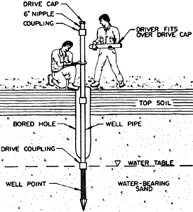
Bored, Drilled or Driven Shaft (deeper than largest surface dimension)
These are examples of what most people envision when they think of a ‘well’!
Notes:
Let’s look at the first part of the definition of a UIC well.
A bored well – here showing a person using a hand auger.
A drilled well – here showing the familiar truck mounted drill rig.
A driven well – here showing it done with a well point.
REMEMBER – any of the wells constructed by these means must be deeper that its largest surface dimension.

Slide 15
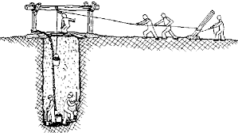
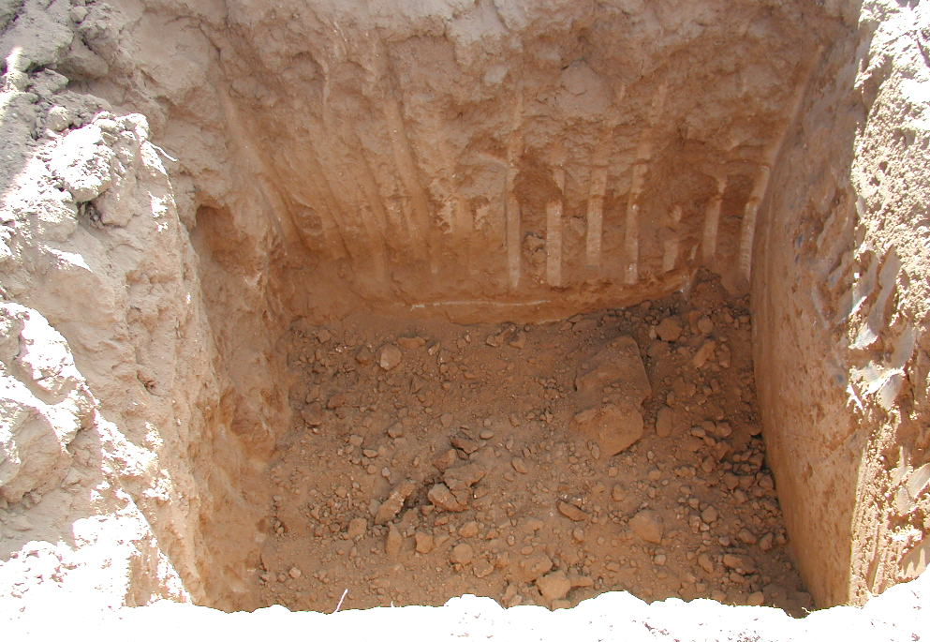
Dug Hole (deeper than largest surface dimension)
Well…
Notes:
The second part of the definition of a UIC well - dug holes.
Here is an example of a manually dug hole.
And here a hole dug by a backhoe.
Again, the hole must be deeper than its largest surface dimension.
It is worth pointing out that for any bored, drilled, driven or dug hole to be a UIC well it must have been constructed for the subsurface emplacement of fluids.

Slide 16
Improved Sinkhole
An improved sinkhole is a naturally-occurring :
karst depression (sinkhole), or
other conduit, fissure, crack or crevice extending into the subsurface,
which has been modified by humans for the purpose of directing and emplacing fluids into the subsurface.
Notes:
The third part of the definition of a UIC well is: ‘improved sinkholes’
<read the slide>
Numerous problems have occurred in the Midwestern states due to improper discharges into sinkholes. While sinkholes are not prevalent in Utah there are areas where they exist and you should be aware of this part of the definition of UIC wells.

Slide 17
What Makes a Sinkhole an ‘Improved Sinkhole’?
A sinkhole or other naturally-occurring opening into the subsurface becomes an ‘improved sinkhole’, and therefore a UIC well, when there are conveyances (pipes, ditches, etc.) that have been constructed, by humans, with the intent of discharging a fluid into the subsurface. Reported discharges into ‘improved sinkholes’ include: sewage, landfill leachate, industrial waste, agricultural runoff.
Discharge into ‘improved sinkholes’ bypass the natural purifying processes that occur in the soil column.

Slide 18
Subsurface Fluid Distribution System
A subsurface fluid distribution system is:
an assemblage of perforated pipes, drain tiles, or
other similar mechanisms intended to distribute fluids below the surface of the ground.
A good example of a subsurface fluid distribution system is an infiltration gallery – an infiltration gallery that exists in the subsurface. This is an important distinction!
Notes:
Finally, the fourth part of the definition of a UIC well is: ‘subsurface fluid distribution system’
<read the bulleted items on the slide>
I’d like to emphasize ‘other similar mechanisms intended to distribute fluids below the surface of the ground.’ We’ll get back to this later.
<read the rest of the slide>

Slide 19
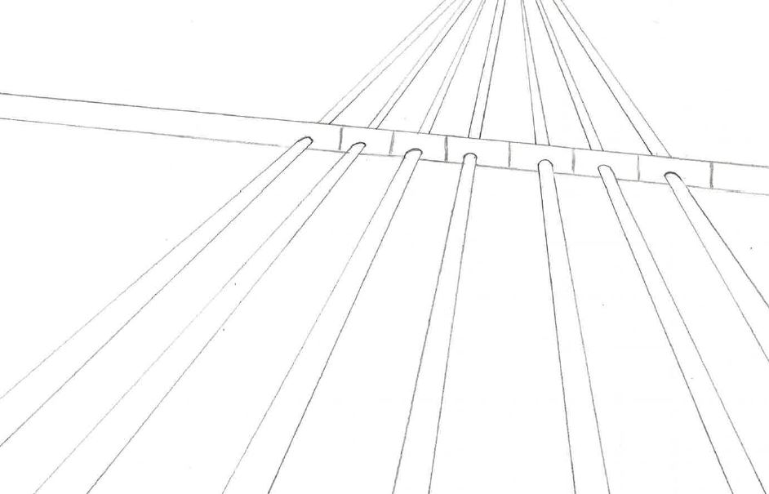
Infiltration Gallery
Notes:
Here is an ‘assemblage of perforated pipes’ designed ‘to distribute fluids below the surface of the ground.’
Right now the assemblage itself is not in the subsurface and therefore NOT a UIC well.
However, if one were to backfill over the ‘assemblage of perforated pipes’ and <click> plant grass then it would be a UIC well.
Or <click> backfill and build a parking lot then it would be a UIC well.

Slide 20
injection wells for Storm Water Management
What is EPA’s Position?
Notes:
We have received numerous comments expressing concerns about the use of Storm Water Drainage Wells in your Storm Water Management Programs. These concerns center around whether EPA allows them.

Slide 21
! ! ! ! !
EPA supports the use of Class V storm water drainage wells.
They are elements in a program for implementing Green Infrastructure and Low Impact Development (LID)
! ! ! ! !
Notes:
These concerns are unfounded!
<read the slide>

Slide 22
EPA, Green Infrastructure, and LID
Green Infrastructure
Green infrastructure uses natural hydrologic features such as vegetation, soils, and natural processes to manage water and provide environmental and community benefits. At the scale of a city or county, green infrastructure refers to the patchwork of natural areas that provides habitat, flood protection, cleaner air, and cleaner water. At the scale of a neighborhood or site, green infrastructure refers to storm water management systems that mimic nature by soaking up and storing water.
SW Drainage Wells
Notes:
So what is Green Infrastructure and Low Impact Development and how do storm water drainage wells fit into these concepts?
<read the slide>
<click> You can see that storm water drainage wells fit into the Green Infrastructure concept.

Slide 23
EPA, Green Infrastructure, and LID
Low Impact Development (LID)
An approach to land development (or redevelopment) that works with nature to manage storm water as close to its source as possible. LID employs principles such as preserving and recreating natural landscape features, minimizing effective imperviousness to create functional and appealing site drainage that treat storm water as a resource rather than a waste product. This approach implements engineered small-scale hydrologic controls to replicate the pre-development hydrologic regime of watersheds through infiltrating, filtering, storing, evaporating, and detaining runoff close to its source.
SW Drainage Wells
Notes:
<read the slide>
<click> Storm water drainage wells fit into this concept too.

Slide 24
Green Infrastructure Collaborative
On October 8, 2014 EPA joined with more than 20 other organizations including other federal agencies, non-governmental organizations, academia and private-sector entities to form the Green Infrastructure Collaborative committed to advancing the adoption of green infrastructure as a means of supporting water quality and community development goals. The Collaborative released a Statement of Support and 7 federal agencies signed a Federal Letter of Support.
http://water.epa.gov/infrastructure/greeninfrastructure/gi_partners.cfm
Notes:
We’d like to take a moment to introduce you to the Green Infrastructure Collaborative.
<read the slide>
Through its partnership in the Green Infrastructure Collaborative, you can see that EPA support GI and LID.

Slide 25
Green Infrastructure Design & Implementation Resources
http://water.epa.gov/infrastructure/greeninfrastructure/gi_design.cfm
Here you will find links to resources developed by many states, counties, and non-profits from throughout the nation.
Design Manuals
Design Tools
Design Challenges
Implementation
Operations & Maintenance
Homeowner Resources
Notes:
Another good website hosted by the EPA is their Green Infrastructure Design and Implementation Resources page.
Here you will find:
Design Manuals
Design Tools
Design Challenges and solutions for overcoming them
Implementation Guides
Operation & Maintenance Manuals
Homeowner Resources
Take some time to explore the resources on this page!

Slide 26
What is a UIC Class V Storm Water Drainage Well?
Examples Please!
Notes:
So we have discussed ‘underground injection’.
We now know the construction criteria a well needs to meet in order to be considered a UIC well.
We know how storm water injection wells can fit into the implementation of Green Infrastructure and Low Impact Development and that EPA supports their use in these schemes.
Now let’s get down to some specific examples.

Slide 27
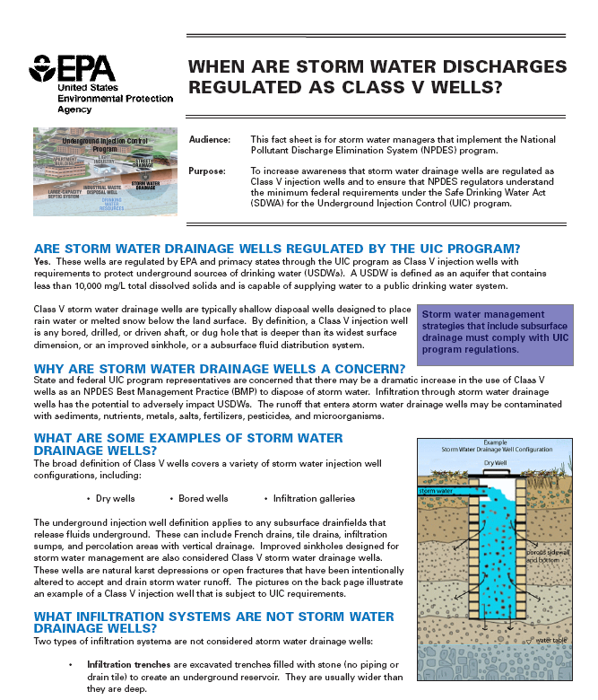
EPA’s Class V Storm Water Fact Sheet
Notes:
In June of 2003, EPA prepared a Fact Sheet entitled When Are Storm Water Discharges Regulated as Class V Wells?
You should have a copy of this.
In the Fact Sheet, EPA discusses generally what is and is not a Class V Storm Water Drainage Well and they give a few examples.

Slide 28
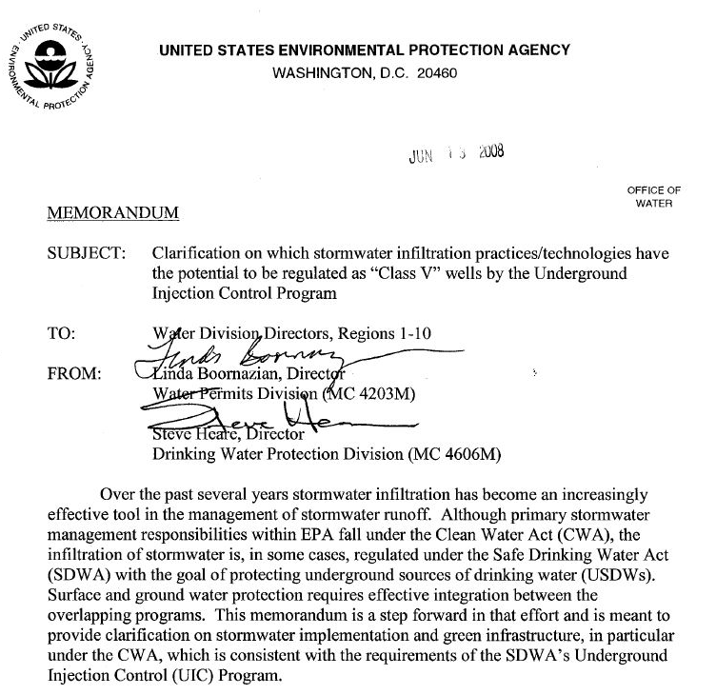
EPA’s June 13, 2008 Memo Clarifying Which SW Infiltration Practices or Technologies MAY be Class V UIC
Notes:
Five years later in June of 2008, EPA issued a memo to clarify what type of infiltration practices may be Class V Storm Water Drainage Wells.
You should also have a copy of this memo.
In this memo, EPA focuses on Green Infrastructure / Low Impact Development elements but also address, on the last page of the memo, ‘dry wells’ , ‘commercially manufactured storm water infiltration devices’, ‘seepage pits’, and ‘improved sinkholes’.
According to the memo, EPA does not consider ‘commercially manufactured storm water infiltration devices’ or simple ‘dry wells’ to be Green Infrastructure elements because they do not allow pretreatment prior to infiltration.
However, pre-treatment BMPs can be implemented before discharge into these. Furthermore, they can facilitate infiltration locally at the point of generation. Therefore, we at DWQ consider these devices options in a GI/LID program.
In the rest of this presentation we want to expand upon these two EPA documents.
OKAY so let’s get down to some concrete examples….

Slide 29
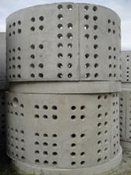
Dry Wells
Notes:
Pre-cast concrete dry wells. We are all familiar with these and, hopefully everyone understands that these are UIC Class V Storm Water Drainage Wells.

Slide 30
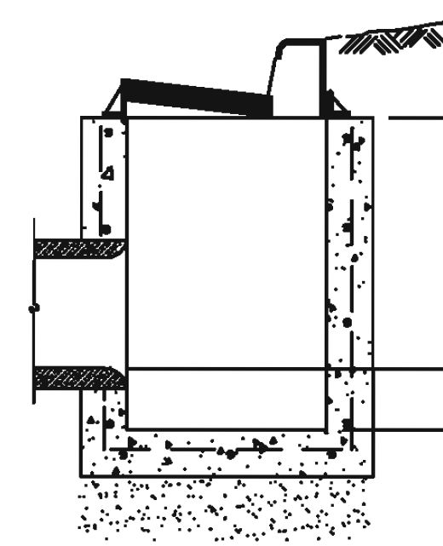
Catchment Basin
Inlet
If bottom of catch basin is open or holes have been drilled through the concrete, then this would be a
UIC well.
Outlet
Notes:
Here we see a pre-cast concrete catchment basin.
So you wouldn’t think that this element would be a UIC Storm Water Drainage Well.
However, <click> if the bottom of the catch basin is open or holes have been drilled through the concrete, then this would be a UIC well because <click> it has been modified to allow infiltration of storm water into the subsurface.

Slide 31
Examples of
Commercially Manufactured Storm Water Infiltration Devices
Notes:
Please refer to page 6, the last page, of the EPA Memo.
We are now going to look at some examples of ‘commercially manufactured storm water infiltration devices’.
As you can see from the Memo, EPA generally considers these Class V wells since their design often meets the definition of a subsurface distribution system.
Well let’s take a closer look.

Slide 32
Disclaimer of Endorsement
The Utah Department of Environmental Quality, Division of Water Quality does not endorse or recommend any commercial products presented herein. All information is provided for general informational purposes only to illustrate the types of products or constructions that are considered UIC Class V Storm Water Drainage Wells.
Notes:
But before we do that I need to read this Disclaimer of Endorsement
<read slide>
Now for some plastic and metal examples….

Slide 33
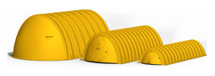
StormTech
Modules
Notes:
We see a lot of StormTech systems going in around the state.

Slide 34
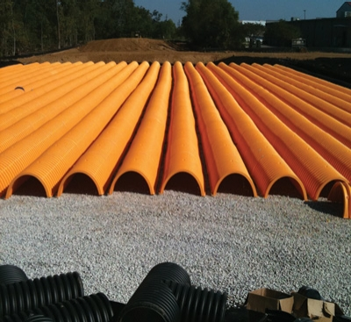
StormTech
Installation

Slide 35
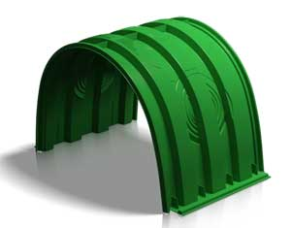
Triton
Module

Slide 36
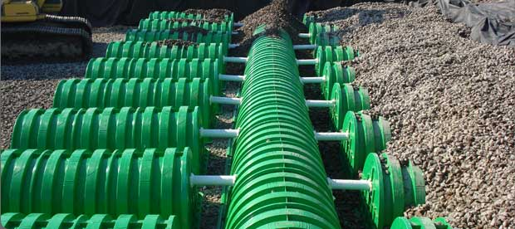
Triton
Installation

Slide 37
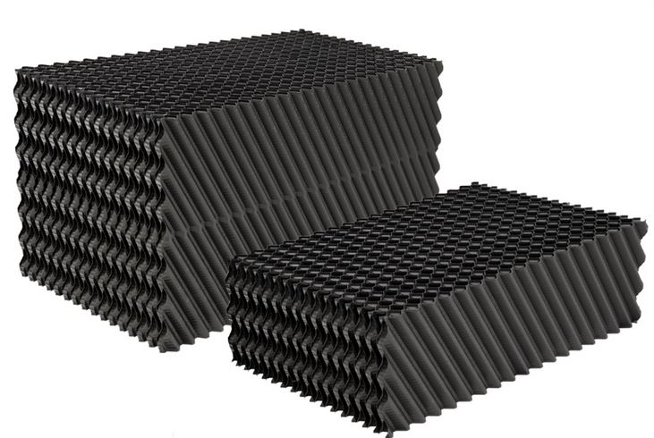
Brentwood StormTank
StormTank Pack
Notes:
Lately, we have seen some Brentwood StormTank systems being installed.
The StormTank Pack modules are designed for use in non-load bearing applications such as under landscaped areas.
Important note here: If installed with an impermeable liner then NOT a UIC because the system was not designed for infiltration rather it was designed for detention/retention.

Slide 38
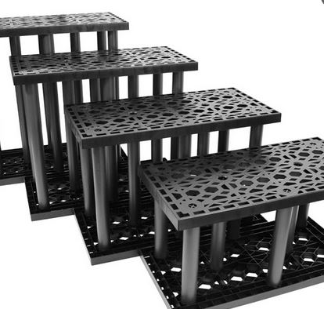
Brentwood StormTank
StormTank
Modules
Notes:
These StormTank Modules can be installed in load-bearing applications for example under parking lots.
Again, if installed with an impermeable liner then NOT a UIC.

Slide 39
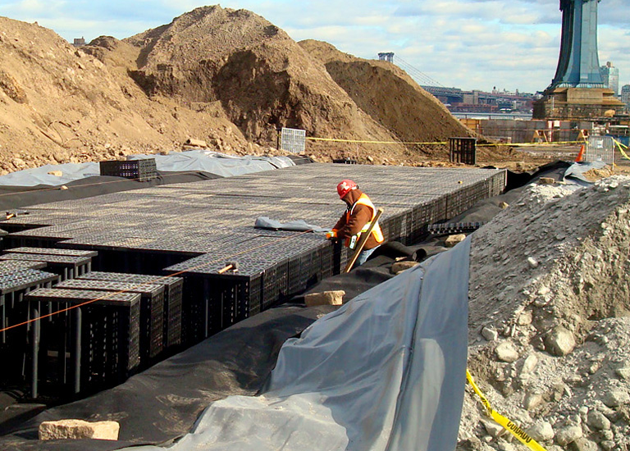
Brentwood StormTank
Installation of StormTank Modules
Notes:
Here is an installation of the load-bearing modules.
Pop Quiz - is this a UIC well??
No – it looks like this has an impermeable liner underneath the modules so the design is for detention/retention.

Slide 40
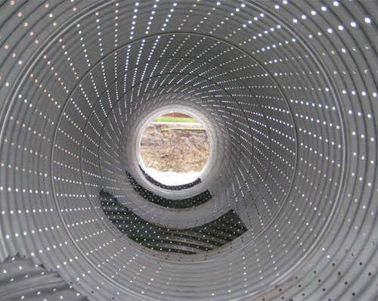
Contech Corrugated Metal Pipe (CMP)
CMP Detail
Notes:
Here is an example of the Contech corrugated metal pipe for a storm water system designed for infiltration.
Contech has several other products that can be used for detention or infiltration or both.

Slide 41
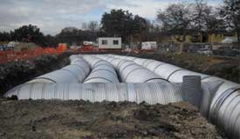
Contech Corregated Metal Pipe (CMP)
CMP Installation

Slide 42
Examples of
Green Infrastructure or Low Impact Development (LID) elements that may be Class V Storm Water Drainage Wells
Notes:
Now we are going to look at some examples discussed on page 5 and 6 of the EPA Memo.

Slide 43
Perforated Pipe Drains: Water Into Drain / Water Out of Drain
Water Into Drain: If piped drains in a drainage system are designed to collect and transport subsurface storm water away from an area to prevent water logging, then these pipes are NOT themselves UIC wells.
Water Out of Drain: If piped drains in a drainage system are designed to distribute storm water to an area for subsurface infiltration, then these pipes are UIC wells.
Notes:
Before we consider these examples, I want to make a distinction between the 2 purposes for including perforated pipe drains in your storm water drainage system.
<click><read the first paragraph>
<click>< read the second paragraph>

Slide 44
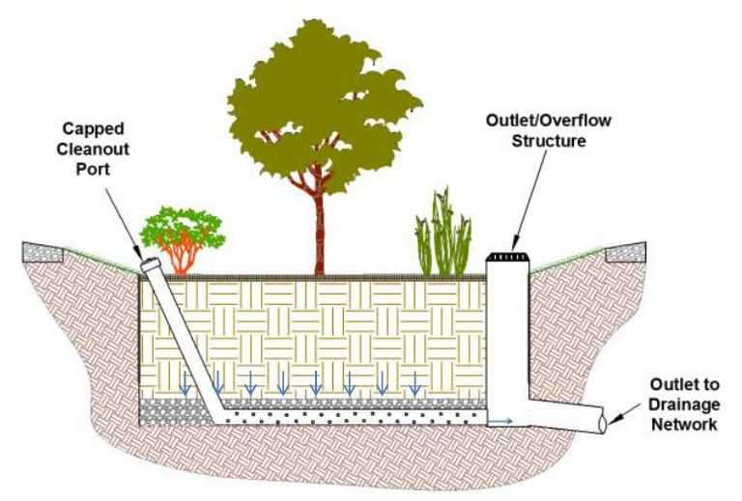
Bioretention Areas
If underdrain discharges to:
dug, bored, drilled, driven well, OR
Improved sinkhole OR
subsurface fluid distribution system, then
UIC
Discharge
Underdrain
Source: San Antonio River Basin Low Impact
Development Technical Guidance Manual
Notes:
Here we see a bioretention area.
<click> It has an underdrain which is plumed to an overflow structure.
The primary purpose of the under drain is to collect and transport the excess storm water that does not infiltrate into the subsurface BELOW the underdrain to the over flow structure and its discharge pipe.
<click><read the callout>

Slide 45
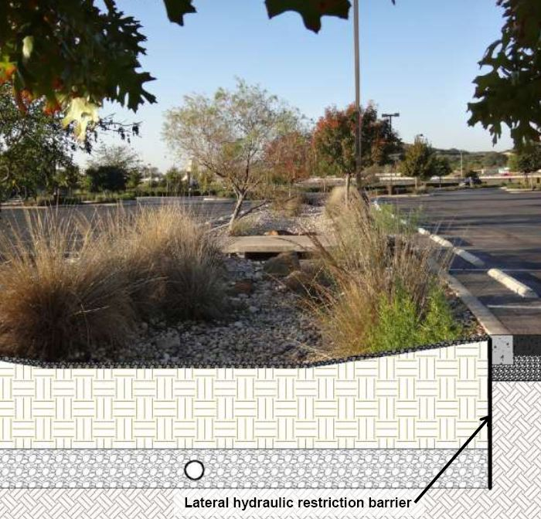
Bioswale with Underdrain
If underdrain discharges to:
dug, bored, drilled, driven well, OR
Improved sinkhole OR
subsurface fluid distribution system, then
UIC
Underdrain
Source: San Antonio River Basin Low Impact
Development Technical Guidance Manual
Notes:
Similarly, here is a bioswale with an underdrain <click>.
Ask yourself the question – Where does the storm water in the underdrain discharge to?
<click><read the callout>

Slide 46
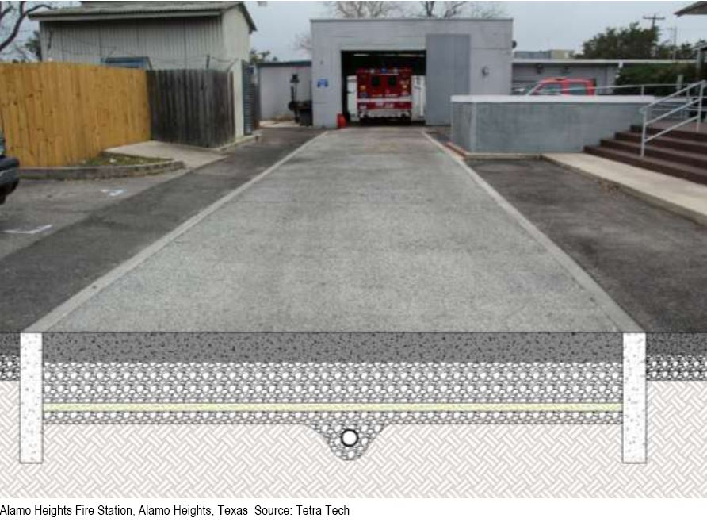
Permeable Pavement with Underdrain
If underdrain discharges to:
dug, bored, drilled, driven well, OR
Improved sinkhole OR
subsurface fluid distribution system, then
UIC
Underdrain
Source: San Antonio River Basin Low Impact
Development Technical Guidance Manual
Notes:
Permeable pavement on its own does not constitute a UIC well.
However, <click> the same thought process as before applies to permeable pavement with an underdrain.
<click><read the call out>

Slide 47
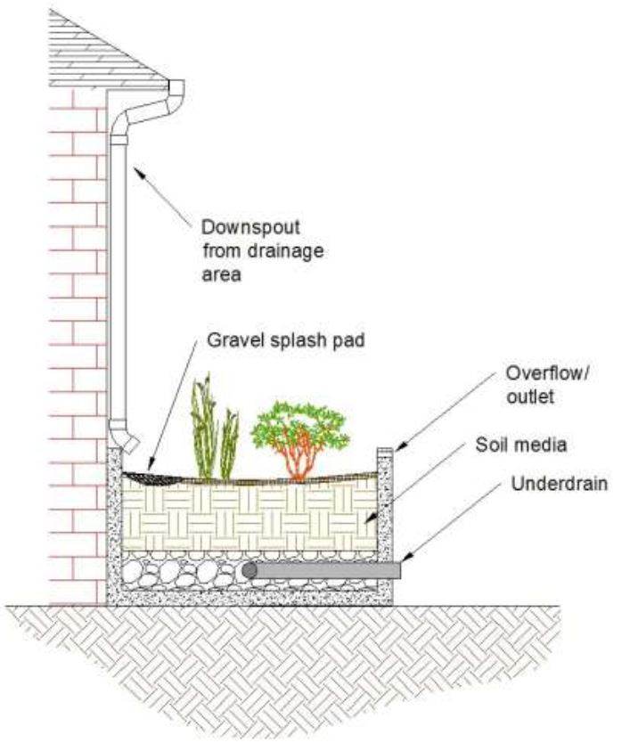
Planter Box with Underdrain
Does the underdrain discharges to:
dug, bored, drilled, driven well, OR
Improved sinkhole OR
subsurface fluid distribution system? If ‘yes’ then
UIC
Underdrain
Source: San Antonio River Basin Low Impact
Development Technical Guidance Manual
Notes:
And not to beat a dead horse, but if your planter box has an underdrain, ask yourself the question
<wait for any reaction from the audience> <click> <read the callout>

Slide 48
How does DWQ Address Storm Water Drainage Wells?
UPDES Storm Water and UIC Programs
Notes:
We hope you now know what questions you need to ask to determine whether or not your storm water drainage system has a Class V Storm Water Drainage Well.
Now how do we at DWQ deal with these wells?

Slide 49
Utah General Permit for Discharges from Small MS4s
4.2.5 - Long-Term Storm Water Management in New Development and Redevelopment (Post-Construction Storm Water Management)
“ The objective of this control measure is for the hydrology associated with new development to mirror the pre-development hydrology of the previously undeveloped site or to improve the hydrology of a redeveloped site and reduce the discharge of storm water. “
Notes:
In your Utah General Permit for Discharges from Small MS4s, there is an objective to maintain pre-development hydrology in new developments or to improve the hydrology of redeveloped sites.

Slide 50
Utah General Permit for Discharges from Small MS4s
4.2.5.3.2 - “ …. the [storm water management] program shall include a process to evaluate and encourage a Low Impact Development (LID) approach which encourages the implementation of structural BMPs, where practicable, that infiltrate, evapotranspire or harvest and use storm water from the site to protect water quality. Structural controls may include green infrastructure practices such as rainwater harvesting, rain gardens, permeable pavement, and vegetated swales.”
As we discussed earlier, SW Drainage Wells fit nicely into the implementation of GI and LID practices.
Notes:
<read the slide>

Slide 51
Utah UPDES Small MS4 General Storm Water Permit Reporting Requirements
Required to identify the UIC Class V Storm Water Drainage Wells in page 3 of the Small MS4 Annual Report Form
This requirement to report UIC Class V Storm Water Drainage Wells may be a recent addition to the requirements of the Small MS4 Annual Report but it merely links the UPDES Storm Water Program to what has been an ongoing requirement of the UIC Program, namely…
Click Here
Notes:
Included in the reporting requirements of your Small MS4 General Storm Water Permit is the requirement to identify the UIC Class V Storm Water Drainage Wells in your jurisdiction. This requirement is on page 3 of the annual report form.
<read second paragraph>

Slide 52
Utah UIC Inventory Information Forms
Owner / operators of UIC storm water drainage wells are required to submit inventory information
http://www.waterquality.utah.gov/UIC/UICForms/UICForms.htm
First time submittal must be accompanied by $180 inventory review fee
Subsequent submittals are considered amendments to the original so no review fee is required.
DWQ sends authorization-by-rule email after reviewing the inventory and entering info into UIC Geodatabase
Click Here

Slide 53
Utah UIC Priority Regarding SW Drainage Wells
It is not a priority of the Utah UIC Program to require the submittal of UIC Inventory Information Forms for Storm Water Drainage Wells on private, single family, residential property.

Slide 54
UIC Class V Storm Water Drainage Wells: The Take Away
Don’t avoid using SW Drainage Wells
EPA and the State UIC Program support their use as another tool in your GI / LID toolbox
Protective BMPs used to discharge to surface water are also relevant in protecting ground water
Review your SW design for any UIC Class V SW drainage wells, if you need assistance in making this determination – call us!

Slide 55
??
Questions
??
Contact
Brianna Ariotti
bariotti@utah.gov
801.536.4351
or
Candace Cady
ccady@utah.gov
801.536.4352

